Slide 1

PRESENTATION
ONLINE FOOD DELIVERY ANALYTICS
End-to-End Data Analytics Project
Tools & Technologies:
Python | Pandas | NumPy | Matplotlib | Power BI | Git & GitHub
Presented by:
Vaishnavi

Slide 2
Project Overview:
The project focuses on analyzing online food delivery data to understand business performance and identify important trends.
Objectives:
Analyze sales and order performance
Identify high-performing cities and food categories
Analyze monthly sales trends
Understand order status and customer ratings
Identify important business patterns
Build an interactive Power BI dashboard
Provide data-driven business recommendations
Problem Statement
How can online food delivery data be analyzed to identify business trends and support better decision-making?

Slide 3
DATASET & DATA PREPARATION:
DATASET OVERVIEW
INITIAL RECORDS: 3,010
FINAL RECORDS: 3,000
COLUMNS: 14
DATA TYPE: SYNTHETIC ONLINE FOOD DELIVERY DATASET
KEY ATTRIBUTES:
ORDER ID
ORDER DATE
CUSTOMER ID
CITY
RESTAURANT
FOOD CATEGORY
QUANTITY
PRICE
DISCOUNT
DELIVERY FEE
PAYMENT METHOD
ORDER STATUS
RATING
TOTAL AMOUNT
DATA PREPARATION:
CHECKED DATA TYPES AND DATA QUALITY
IDENTIFIED MISSING VALUES
REMOVED 10 DUPLICATE RECORDS
CHECKED INVALID QUANTITY AND PRICE VALUES
CONVERTED ORDER DATE TO DATETIME FORMAT
CREATED TOTAL SALES FOR ANALYSIS

Slide 4
EDA Performed:
Dataset structure and summary statistics
Missing-value analysis
Duplicate detection
City-wise sales analysis
Food category analysis
Restaurant-wise sales analysis
Monthly sales trend analysis
Correlation analysis
Outlier detection
Key Findings:
Total Sales: ₹1.26M approximately
Unique Orders: 3,000
Average Sales per Order: ₹420.22
Average Rating: 4.09 / 5
Top City: Bengaluru
Top Food Category: Pizza
Highest Sales Month: May

Slide 5
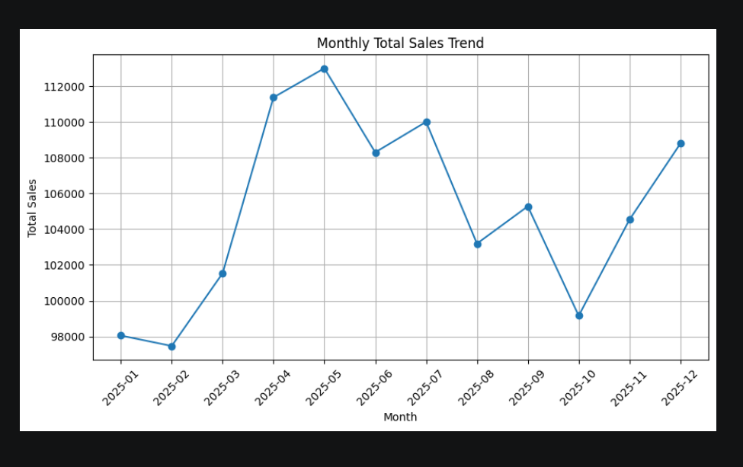
Key Visualizations:
Monthly Sales Trend
Shows the variation in sales from January to December.

Slide 6
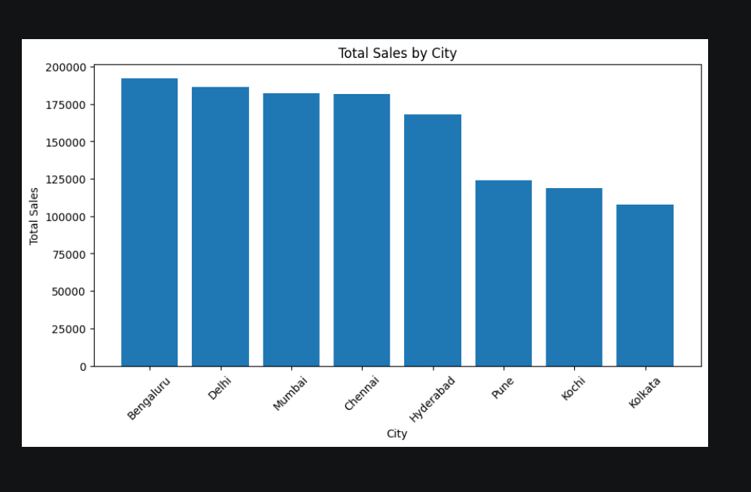
Sales by City
Compares the sales performance of different cities.

Slide 7
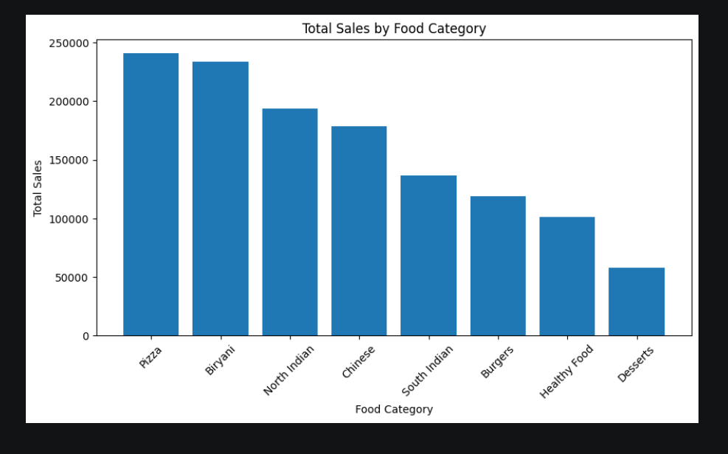
Sales by Food Category
Identifies the highest-performing food categories.

Slide 8
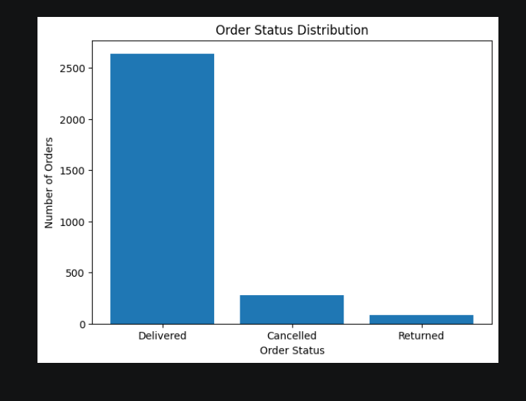
Order Status Distribution
Shows the proportion of delivered, cancelled, and returned orders.

Slide 9
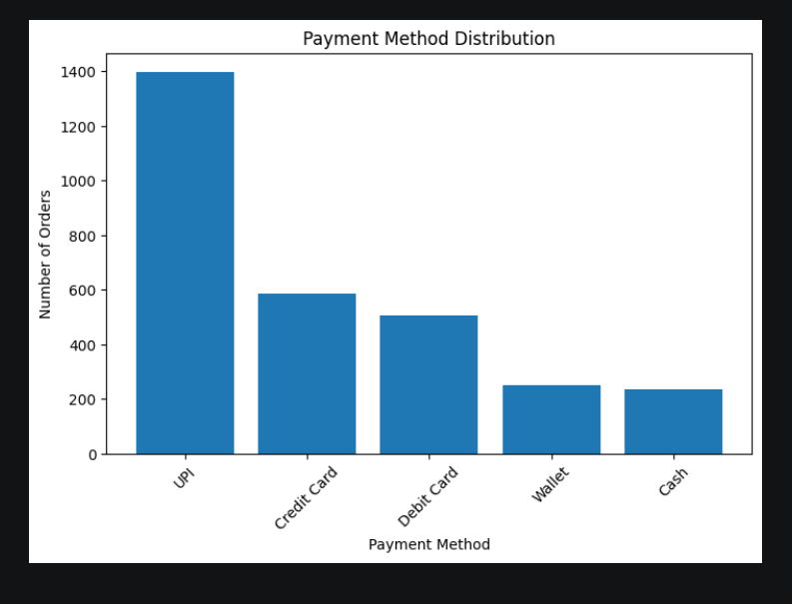
PAYMENT METHOD DISTRIBUTION
HIGHLIGHTS CUSTOMER PAYMENT PREFERENCES

Slide 10
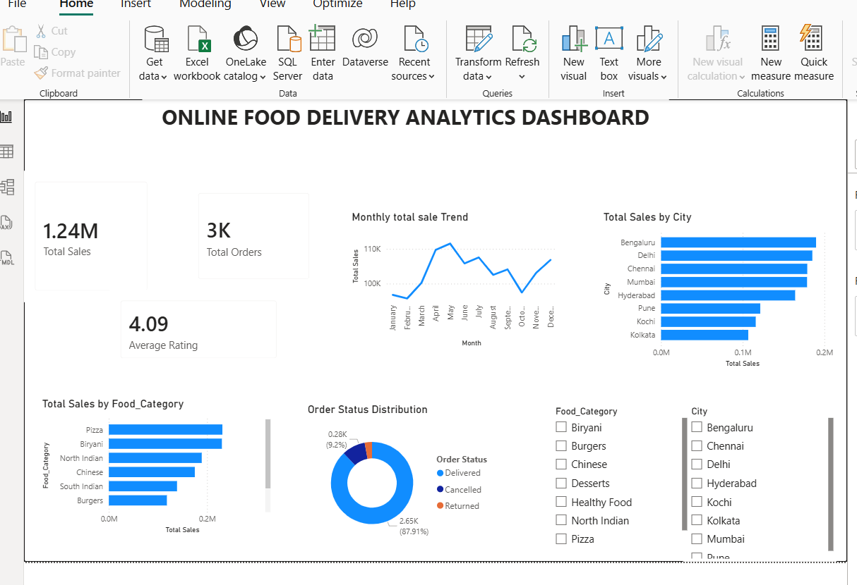
POWER BI DASHBOARD:
INTERACTIVE POWER BI DASHBOARD
THE POWER BI DASHBOARD PROVIDES AN INTERACTIVE VIEW OF THE OVERALL FOOD DELIVERY BUSINESS PERFORMANCE.
KEY PERFORMANCE INDICATORS:
KPI VALUE
TOTAL SALES ₹1.24M
TOTAL ORDERS 3K
AVERAGE RATING 4.09
DASHBOARD COMPONENTS
MONTHLY TOTAL SALES TREND
TOTAL SALES BY CITY
TOTAL SALES BY FOOD CATEGORY
ORDER STATUS DISTRIBUTION
FOOD CATEGORY FILTER
CITY FILTER

Slide 11
BUSINESS INSIGHTS & RECOMMENDATIONS
MAJOR BUSINESS INSIGHTS:
BENGALURU GENERATED THE HIGHEST SALES AMONG THE CITIES.
PIZZA WAS THE HIGHEST-PERFORMING FOOD CATEGORY.
BIRYANI ALSO SHOWED STRONG SALES PERFORMANCE.
MAY RECORDED THE HIGHEST MONTHLY SALES.
87.91% OF ORDERS WERE DELIVERED SUCCESSFULLY.
THE OVERALL AVERAGE CUSTOMER RATING WAS 4.09/5.
RECOMMENDATIONS:
PROMOTE HIGH-PERFORMING CATEGORIES SUCH AS PIZZA AND BIRYANI.
STRENGTHEN MARKETING AND RESTAURANT PARTNERSHIPS IN HIGH-PERFORMING CITIES.
INTRODUCE TARGETED OFFERS DURING LOWER-SALES MONTHS.
MONITOR CANCELLED AND RETURNED ORDERS TO IMPROVE SERVICE QUALITY.

Slide 12
CONCLUSION
SUCCESSFULLY COMPLETED AN END-TO-END DATA ANALYTICS PROJECT.
CLEANED AND PREPARED THE FOOD DELIVERY DATASET.
PERFORMED EXPLORATORY DATA ANALYSIS TO IDENTIFY IMPORTANT PATTERNS.
CREATED MEANINGFUL DATA VISUALIZATIONS USING PYTHON.
DEVELOPED AN INTERACTIVE POWER BI DASHBOARD.
IDENTIFIED MAJOR BUSINESS INSIGHTS FROM SALES AND ORDER DATA.
PROVIDED ACTIONABLE RECOMMENDATIONS BASED ON THE ANALYSIS.
USED GIT AND GITHUB FOR PROJECT VERSION CONTROL AND DOCUMENTATION.

